Slide 1
Net Centric Programming Lecture 3
Adeel-ur-Rehman

Slide 2
Java Terminology
Java acronyms are plentiful and confusing. Here are the basics.
 JVM – Java Virtual Machine
 Translates Java bytecode to machine code
 API – Application Programming Interface
 Java code libraries
 JRE – Java Runtime Environment
 The JVM and the Java API together
 JDK (formerly SDK) – Java Development Kit
 JRE + tools (compiler, debugger) for developing Java applications and applets
 J2SE or Java SE – Java 2 Platform, Standard Edition
 The JRE and JDK products taken as a “family”
 To learn more about Java Platforms, visit:
https://docs.oracle.com/en/java/
 We’ll use one of the latest stable Java version, e.g. Java 23 or Java 21. Download Java SE Development Kit from following link.
https://www.oracle.com/pk/java/technologies/downloads/

Slide 3
The Eclipse IDE
An integrated development environment (IDE) for writing Java programs. Contains (minimally):
 editor
 debugger
 Java compiler
 Java JVM
 Free download for your PC
 We’ll show you more later

Slide 4
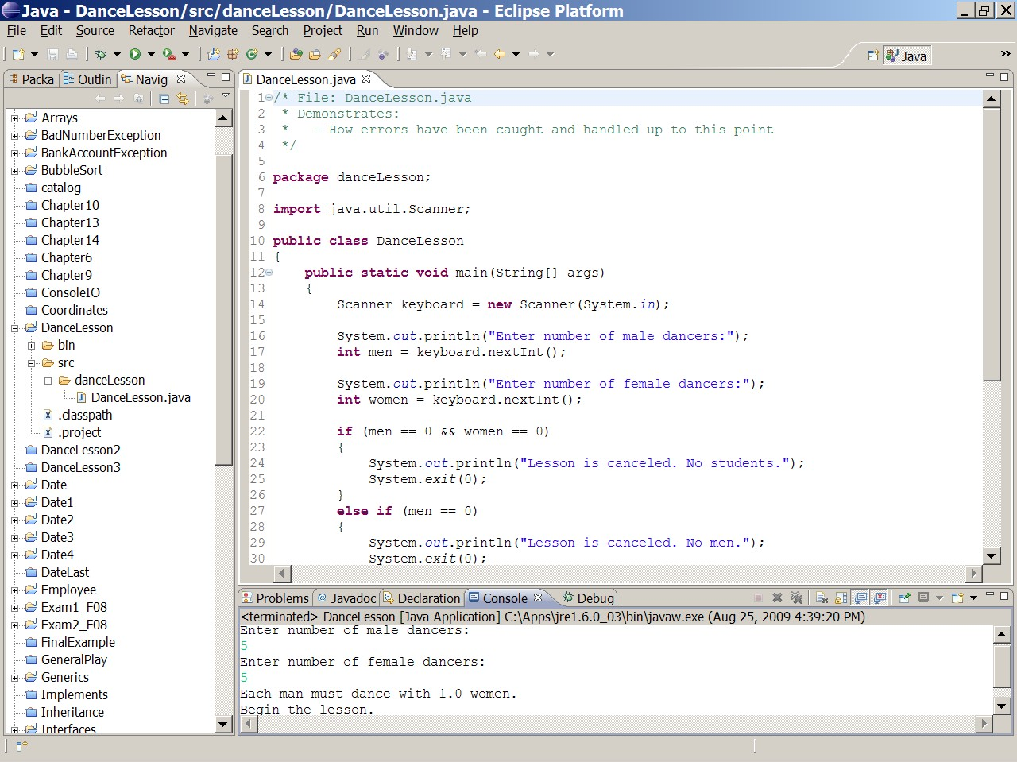
Eclipse IDE Screenshot

Slide 5
Compiling and Running Java
JRE for Linux
Java Code
Java Bytecode
javac Hello.java
Java compiler
Java interpreter (JVM) translates bytecode to machine code in JRE
Hello.java
Hello.class
JRE for Windows

Slide 6
Java Basics

Slide 7
Simple Java Program
public class MyClass {
public static void main(String[] args) {
System.out.print(“Hello, world”);
}
}

Slide 8
Java Program Basics
All code has to be inside some class definition
– For now, we can think of this like in terms of file/module, or namespace
All programs begin execution at main()
This is much like in C, but…
You can have a different main() in every class: pick at runtime
System.out.print()
Outputs text to the screen
System.out.print(“Hello”);
There is also System.out.println( ), which terminates w/newline

Slide 9
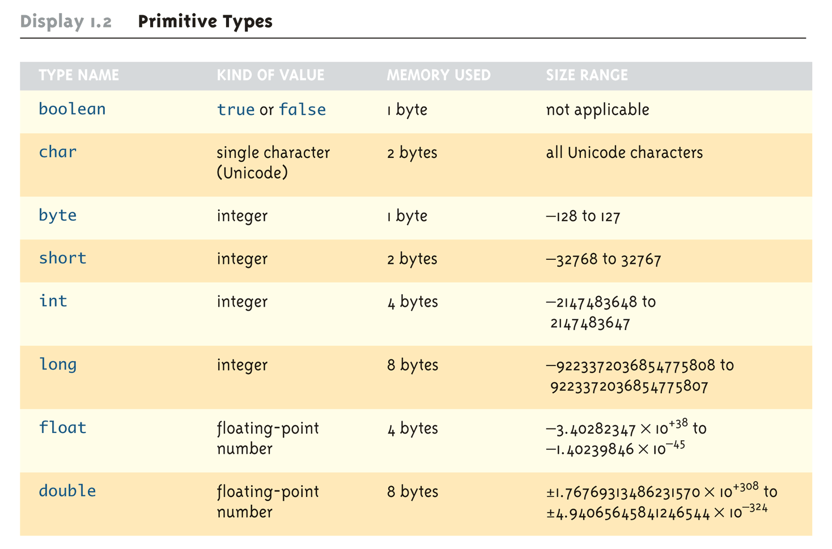
Primitive Data Types

Slide 10
Variable Declarations
Format: type variable-name;
Examples:
int total; float salary;
When we declare a variable, we tell Java:
When and where to set aside memory space for the variable
How much memory to set aside
How to interpret the contents of that memory: the specified data type
What name we will be referring to that location by: its identifier

Slide 11
Naming Conventions
Variables, methods, and objects
Start with a lowercase letter
Indicate "word" boundaries with an uppercase letter
Restrict the remaining characters to digits and lowercase letters
Can use underscores
topSpeed bankRate1 timeOfArrival
Classes
Start with an uppercase letter
Otherwise, adhere to the rules above
FirstProgram MyClass String

Slide 12
Java Keywords (till Java 6)
abstract | boolean | break | byte | case | catch | char
class | const | continue | default | do | double | else
extends | final | finally | float | for | goto | if
implements | import | instanceof | int | interface | long | native
new | package | private | protected | public | return | short
static | super | switch | synchronized | this | throw | throws
transient | try | void | volatile | while

Slide 13
Operators
Assignment:
Numeric:
Relational:
Boolean:
Bitwise:
=, +=, -­‐=, *=, /=, %=…
+, -­‐, *, /, %, ++, - - …
==, !=, <, >, <=, >=, …
&, &&, |, ||, !
&, |, ^, ~, <<, >>, >>> …

Slide 14
Arithmetic Operators Rules of Operator Precedence
Operator(s) ( )
Precedence & Associativity
Evaluated first. If nested, innermost first. If on same level, left to right.
Evaluated second. If there are several, evaluated left to right.
Evaluated third. If there are several, evaluated left to right.
Evaluated last, right to left.
* / %
+ –
=

Slide 15


Practice With Evaluating Expressions
Given integer variables a, b, c, d, and e, where a = 1, b = 2, c = 3, d = 4, evaluate the following expressions:
a + b - c + d a * b / c
1 + a * b % c a + d % b - c
e = b = d + c / b - a

Slide 16
A Hand Trace Example
int answer, value = 4 ; Code
Value
Answer
value = value + 1 ; value++ ;
++value ;
answer = 2 * value++ ;
answer = ++value / 2 ; value-- ;
--value ;
answer = --value * 2 ; answer = value-- / 3 ;

Slide 17
More Practice
Given
int a = 1, b = 2, c = 3, d = 4 ;
What is the value of this expression?
++b / c + a * d++
What are the new values of a, b, c, and d?

Slide 18
Assignment Operators
= += -­‐=
Statement
a = a + 2 ; a = a -­‐ 3 ; a = a * 2 ; a = a / 4 ; a = a % 2 ;
b = b + ( c + 2 ) ; d = d * ( e -­‐ 5 ) ;
*= /= %=
Equivalent Statement a += 2 ;
a -­‐= 3 ;
a *= 2 ; a /= 4 ; a %= 2 ;
b += c + 2 ;
d *= e -­‐ 5 ;

Slide 19
Type Casting
A type cast takes a value of one type and produces a value of another type with an "equivalent" value.
int n, m; double ans
= n / (double)m;
OR
double
ans = (double)n / m;
OR
double ans = (double)n / (double)m;
– The type and value of n and m do not change.

Slide 20
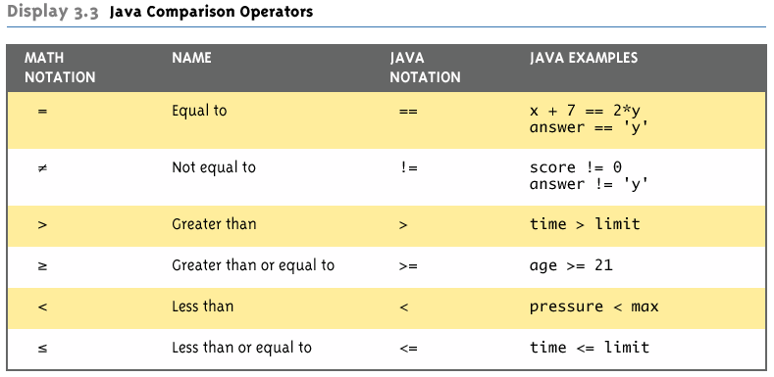
Java Comparison Operators

Slide 21
Boolean Expressions
Operators: &&, ||, !
Boolean expression evaluates to the values true or
false
Simple Boolean expressions:
time < limit yourScore == myScore
Two equal signs (==): equality testing
Single equal sign (=): assignment

Slide 22
Java Flow Control
Decisions
if, if-else, switch
Loops
for, while, do-while
Boolean expressions
Java flow control constructs evaluate Boolean expressions
The expression must be of boolean type:
Cannot do: “if (--c)…”; must do: “if (--c != 0)…”

Slide 23
if-else & while Statements
if ( condition₁ ) {
statement(s)
} else if ( condition₂ ) {
statement(s)
}
. . .
} else {
statement(s)
}
/* more else if clauses may be here */
/* the default case */
while ( condition ) {
statement(s)
}

Slide 24
The 3 Parts of a Loop
…
int i = 1 ;
initialization of loop control variable
// count from 1 to 100 while ( i < 101 ) { System.out.println( i ) ;
test of loop termination condition
i = i + 1 ;
modification of loop control variable
}
return 0 ;
}

Slide 25
Example
int children = 10; cookies=0;
while ( children > 0 ) {
children = children - 1 ;
cookies = cookies * 2 ;
}
factorial = 1;
while ( myNumber > 0 ) {
factorial *= myNumber;
--myNumber;
}
return factorial;

Slide 26
The for Loop Repetition Structure
The for loop handles details of the counter-controlled loop “automatically”.
The initialization of the the loop control variable, the termination condition test, and control variable modification are handled in the for loop structure.
for ( i = 1; i < 101; i = i + 1) {
initialization
modification
}
test

Slide 27
When Does a for Loop Initialize, Test and Modify?
Just as with a while loop, a for loop
initializes the loop control variable before beginning the first loop iteration
performs the loop termination test before each iteration of the loop
modifies the loop control variable at the very end of each iteration of the loop
The for loop is easier to write and read for counter-controlled loops.

Slide 28
for Loop Examples
A for loop that counts from 0 to 9:
// modify part can be simply “i++”
for ( i = 0; i < 10; i = i + 1 ) {
System.out.println( i ) ;
}
…or we can count backwards by 2ʼs :
// modify part can be “i -= 2”
for ( i = 10; i > 0; i = i - 2 ) {
;
System.out.println( i )
}

Slide 29
The do-­‐while Repetition Structure
do {
statement(s)
} while ( condition ) ;
The body of a do-while is ALWAYS executed at least once. Is this true of a while loop? What about a for loop?

Slide 30
The break & continue Statements
The break & continue statements can be used in while, do-while, and for loops to cause
the remaining statements in the body of the loop to be skipped; then:
break causes the looping itself to abort, while…
continue causes the next turn of the loop to start. In a for loop, the modification step will still be executed.

Slide 31
Example break in a for Loop
…
int | i ; |  | •OUTPUT:
for | (i = 1; i < 10; i = i + | 1) {
if | (i == 5) { |  | • 1 2 3 4
break;
}
System.out.println(i);
}
•Broke out of loop at i = 5.
System.out.println(“\nBroke out of loop at i = “ + i);

Slide 32
Example continue in a for Loop
…
int i;
for (i = 1; i < 10; i = i + 1) { if (i == 5) {
continue;
OUTPUT:
1 2 3 4 6 7 8 9
}
System.out.println(i);
}
System.out.println(“Done”);
Done.

Slide 33
Problem: continue in while Loop
// This seems equivalent // in previous slide—but | to is | for loop it?? | OUTPUT:
… int i = 1; |  |  | ???
while (i < 10) {
if (i == 5) {
continue;
}
System.out.println(i); i = i + 1;
}
System.out.println(“Done”);

Slide 34
The switch Multiple-Selection Structure
switch ( integer expression )
{
case constant₁ :
statement(s)
break ; case constant₂ : statement(s)
break ;
. . .
default: : statement(s) break ;
}
Notes:
break
and default are
If no break, execution flows through to next case
If no default, switch might not do execute anything
keywords

Slide 35
switch Example
switch ( day ) {
case 1:
System.out.println (“Monday\n”) ;
break ;
case 2:
System.out.println (“Tuesday\n”) ;
break ;
case 3:
System.out.println (“Wednesday\n”) ;
break ;
case 4:
System.out.println (“Thursday\n”) ;
break ;
case 5:
System.out.println (“Friday\n”) ;
break ;
case 0:
case 6:
System.out.println (“Weekend\n”) ;
break ;
default:
System.out.println (“Error -- invalid day.\n”) ;
break ;
}

Slide 36
Variable Scope
Variable scope:
That set of code statements in which the variable is known to the compiler
Where it can be referenced in your program.
Limited to the code block in which it is defined.
– A code block is a set of code enclosed in braces ({ }).
One interesting application of this principle allowed in Java involves the for loop construct.

Slide 37
for-loop index
Can declare and initialize variables in the heading of a for loop.
These variables are local to the for-loop.
They may be reused in other loops.
String s
= “hello world”;
int count = 1; for (int i = 0;
{
i < s.length();
i++)
count *= 2;
}
//using 'i'
here
generates
a compiler
error

Slide 38
Named Constants
No “hard coded” values inside code!
Declare constants as named constants, and use their name instead
public | static | final | int INCHES_PER_FOOT | = | 12;
public | static | final | double RATE = 0.14;
The “final” modifier prevents a value from being changed inadvertently.
More about public and static later
Naming convention for constants
Use all uppercase letters
Designate word boundaries with an underscore character

Slide 39
Comments
Line comment
Begins with the symbols //
Compiler ignores remainder of the line
Used for the coder or for a programmer who modifies the code
if (birthYear > currentYear) then . . .
Block comment
// birth year is invalid
Begins with /* and ends with */
Compiler ignores anything in between
Can span several lines
Provides documentation for the users of the program
/* File: Date Author: Joe Smith Date: 9/1/09
*/

Slide 40
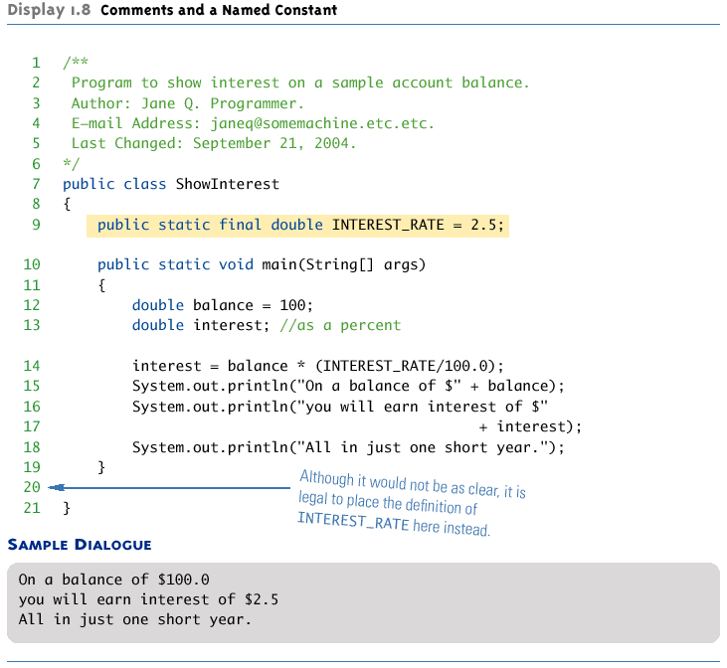
Comments & Named Constants

Slide 41
Strings

Slide 42
The String Class
No primitive type for strings in Java
String is a predefined class in the Java language.
Used to store and process strings
Objects of type String are made up of strings of characters within double quotes.
Any quoted string is a constant of type String.
"Live long and prosper."
A variable (object) of type String can be given the value of a String constant.
String String String
blessing = “Live long and prosper.“
greeting
= “Hello”;
name = “Bob”;

Slide 43
String Concatenation
Use the + operator
String greeting = “Hello”; String name = “Bob”;
greeting + name is equal to “HelloBob”
Any number of strings can be concatenated together.
When a string is combined with almost any other type of item, the result is a string
“The | answer | is “ + 42 evaluates to
“The | answer | is 42“
Strings also support the += operator
String greeting = ”Hello”;
greeting += “ Bob”;
changes greeting to “Hello Bob”

Slide 44
String Methods
The String class contains many useful methods (operations) for string- processing applications.
Calling a String method:
String-object-name.method-name (arguments); OR
variable = String-object-name.method-name (arguments);
Example
String greeting
= “Hello“;
//greeting is an object
int count = greeting.length(); System.out.println(“Length is “ + greeting.length());

Slide 45
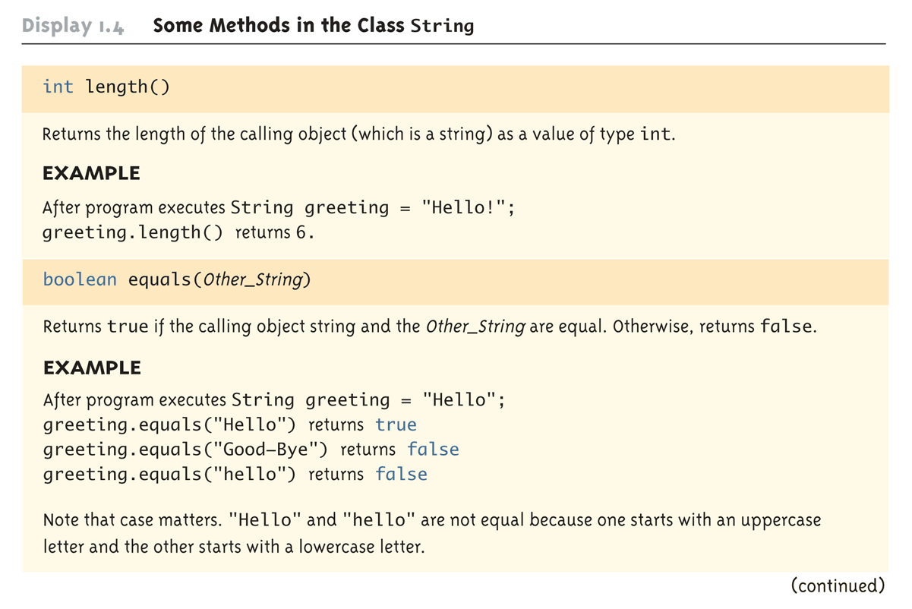
Some Methods in the Class String (1 of 4)

Slide 46
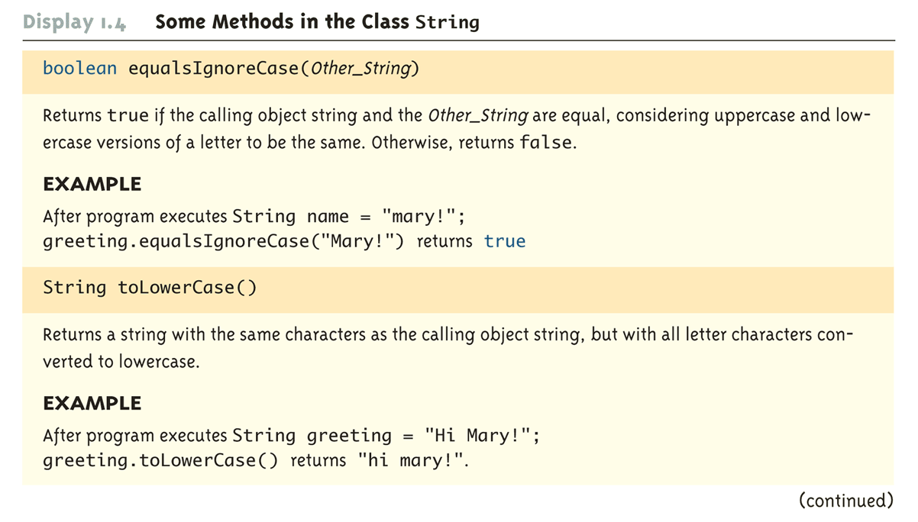
Some Methods in the Class String (2 of 4)

Slide 47
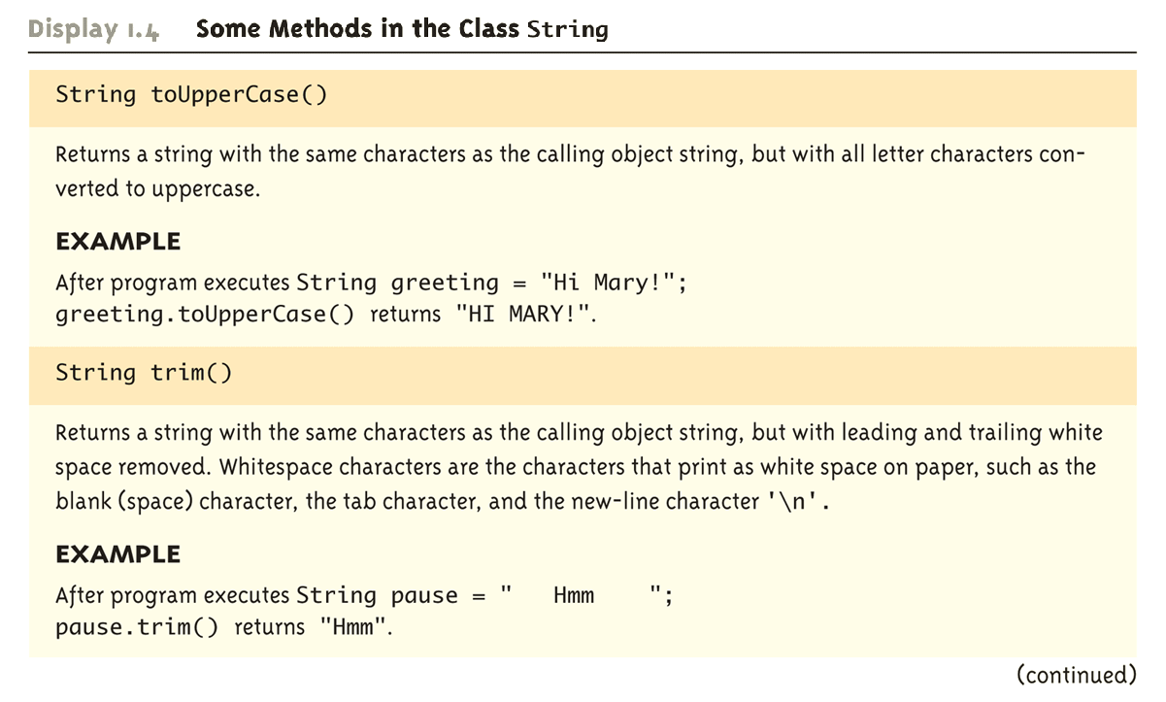
Some Methods in the Class String (3 of 4)

Slide 48
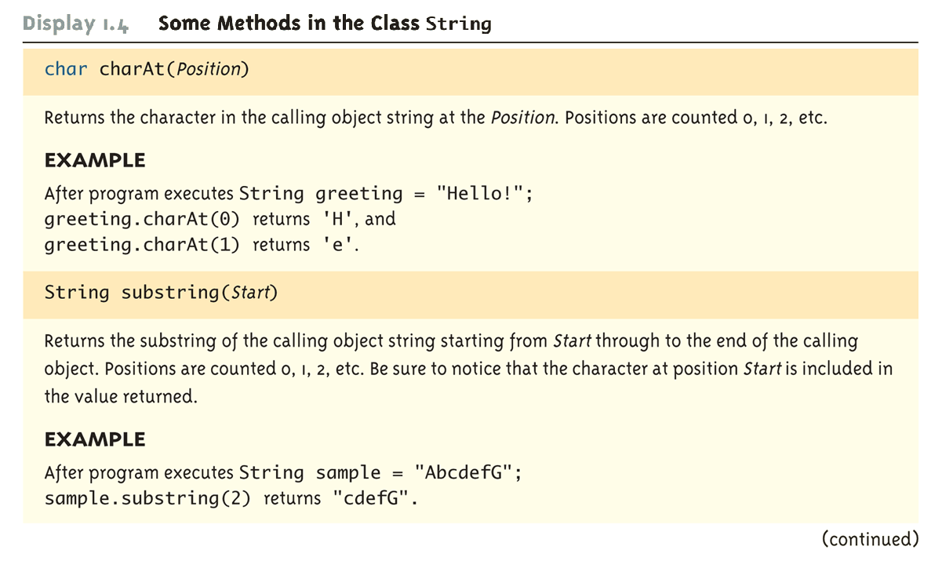
Some Methods in the Class String (4 of 4)

Slide 49
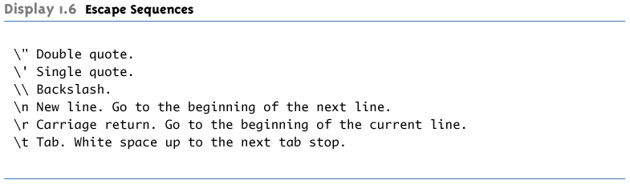
Escape Sequences
The character following the backslash does not have its usual meaning.
It is formed using two symbols, but regarded as a single character.

Slide 50
Pitfall: Using == with Strings
The equality operator (==) can test the stored values of two values of a primitive type.
int x = 5, y = 5;
if (x == y) . . . // returns true
When applied to two objects, == tests to see if they are stored in the same memory location. Example:
String string1 String string2 if (string1 ==
= “hello”;
= “hello”;
string2) . . .
// returns false
To test two strings to see if they have equal values, use the String method equals, or equalsIgnoreCase.
if (string1.equals(string2)) // returns true or
if (string1.equalsIgnoreCase(string2)) // returns true

Slide 51
Other Pitfalls with Strings
Be careful with concatenation:
– Consider the following two expressions:
4 + 2 + “is
vs.:
“The answer
the answer to everything”;
to everything is “ + 4 + 2;
A String is immutable
There is no way to modify any chars in a String:
E.g.: “someString.charAt(x)” doesnʼt let you change that char
But what does “immutable” really mean? Consider:
String immutable = “Yes”; immutable = “No”;
// Why is this allowed? And what of “+=“?

Slide 52
Arrays

Slide 53
Arrays
Array: A data structure used to process a collection of data that is all of the same type.
An array is declared and created using the new
operator.
BaseType[] ArrayName = new BaseType[size];
The size
may be given
as a non-negative integer, or
as an expression that evaluates to a nonnegative integer.
char[] line = new char[80];
double[] reading = new double[count];

Slide 54
Declaring vs. Creating Arrays
Example
double[] score = new double[5];
or, using two statements:
double[] score;
score = new double[5];
// declares
// creates
The 1st statement declares score to be of the array
type double[]
(an array of doubles).
The 2nd statement
creates an array with five numbered values of type double
makes the variable score a name for the array

Slide 55
The length Instance Variable
An array is considered to be an object.
Every array has exactly one instance variable
(characteristic) named length.
When an array is created, the instance variable
length is automatically set equal to its size.
The value of length cannot be changed (other than by creating an entirely new array using new).
double[] score = new double[5];
Given score above, score.length has a value of 5.

Slide 56
Initializing Arrays
An array can be initialized when it is declared.
Example:
int[] age = {2, 12, 1};
Given age above, age.length automatically has a value of 3.
System.out.print(“Length is “ + age.length);
prints
Length is 3

Slide 57
Notes on Arrays
index starts at 0.
arrays can’t shrink or grow.
each element is initialized.
array bounds checking (no overﬂow!)
– ArrayIndexOutOfBoundsException

Slide 58
Initializing Arrays
Using a for loop,
double[] reading = new double[100];
for(int index = 0; index < reading.length; index++){
reading[index] = 42
}
Using array literals:
int[] foo = {1,2,3,4,5};
String[] names
= {“Joe”, “Sam”};
If the elements of an array are not initialized
explicitly, they will automatically be initialized to the default value for their base type.

Slide 59
An Array Coding Exercise
Write a code fragment that finds the smallest value in an array of integers.

Slide 60
Arrays as Parameters
An array may be a method argument. Example:
public void doubleElements(double[] a)
{
for (int i = 0; i < a.length; i++) a[i] = a[i]*2;
}
// a = address
// notice use
// of a.length
Given arrays of double as follows:
double[] a = new double[10]; double[] b = new double[30];
the method doubleElements can be invoked as follows:
doubleElements(a); doubleElements(b);

Slide 61
Pitfall: Use of = with Arrays
An array variable contains the memory address of the array it names.
The assignment operator (=) only copies this memory address.
int a[ ] = {1, 2, 3};
int b[ ] = new int[3];
b = a; // b and a are now
names for
// the same array
Copyright © 2008 Pearson Addison-Wesley. All rights
reserved

Slide 62
Pitfall: Use of = with Arrays
A for loop is usually used to make two different arrays have the same values in each indexed position.
int | i;
int | a[ | ] | = {1, | 2, 3};
int | b[ | ] | = new | int[3];
for | (i | = | 0; (i | < a.length) && (i < b.length); i++)
b[i] = a[i];
– Note that the above code will not make b an exact copy of a, unless a and b have the same length

Slide 63
Pitfall: Use of == with Arrays
The equality operator (==) only tests two arrays to see if they are stored in the same memory location.
(a == b)
is true if a and b reference the same array. Otherwise, it is false.
An equalsArray
method can be defined to
test arrays for value equality.
– The following method tests two integer arrays to see if they contain the same integer values.

Slide 64
Code to Test for Value Equality
public boolean equalsArray(int[] a, int[] b)
{
if (a.length == b.length)
{
int i = 0;
boolean elementsMatch = true;
while (i < a.length && elementsMatch)
{
if (a[i] != b[i]) elementsMatch = false;
i++;
}
return elementsMatch;
}
else
return false;
}

Slide 65
Strings and Arrays Are Objects
Itʼs important to keep in mind that despite syntactic shortcuts (e.g., “hello” + “bye”, foo[x]), strings and arrays are objects
They have real methods
They have constructors, which must be called to create new instances.
Otherwise, you just have null references.

Slide 66
Exception Handling

Slide 67
Exceptions
Terminology:
throw an exception: signal that some condition (possibly an error) has occurred.
catch an exception: deal with the error (or whatever).
In Java, exception handling is necessary (forced by the compiler)!

Slide 68
Try/Catch/Finally
try {
// code
that can throw
an exception e1) {
exception e2) {
} catch
(ExceptionType1
// code to handle the
} catch (ExceptionType2
// code to handle
the exception
e) {
} catch (Exception
to handle other
{
// code to
}
// code
exceptions
} finally
run after
try or any
catch

Slide 69
Exception Handling
Exceptions take care of handling errors
– instead of returning an error, some method calls will throw an exception.
Can be dealt with at any point in the method invocation stack.
Forces the programmer to be aware of what errors can occur and to deal with them.

Slide 70
Exception Example
static String squareNumberString(String str) { int n;
try {
n = Integer.parseInt(str);
} catch (NumberFormatException e) { System.err.println(“Error: invalid integer \”” + str + ”\””); System.exit(1);
}
return “”+ Math.pow(n,2);
}

Slide 71
A Better Exception Example
static String squareNumberString(String str) { int n;
try {
n = Integer.parseInt(str);
} catch (NumberFormatException e) {
throw new InvalidArgumentException(“str must contain a valid integer”);
}
return “”+ Math.pow(n,2);
}

Slide 72
Objects and Classes

Slide 73
What’s an Object?
 Must first define a class
 A data type containing
 Attributes - make up the object’s “state”
 Operations - define the object’s “behaviors”
Bank Account
account number owner’s name balance
interest rate more?
deposit money withdraw money check balance transfer money more?
name
String
sequence of characters more?
compute length concatenate test for equality more?
attributes (state)
operations (behaviors)

Slide 74
So, an object is …
 a particular “instance” of a class.
Berg’s Account
Frede’s Account
Mitchell’s Account
12-345-6 Jen Berg |  | 65-432-1 Dennis Frede |  | 43-261-5 Sarah Mitchell
$1,250.86 |  | $5.50 |  | $825.50
1.5% |  | 2.7% |  | 2.5%
For any of these accounts, one can
deposit money
withdraw money
check the balance
transfer money

Slide 75
Class Definitions
You already know
how to use classes and the objects created from them, and
how to invoke their methods.
For example, you have already been using the predefined String class.
String
name = “Fido”;
System.out.println(“name length ());
= “ + name.length

Slide 76
A Class Is a Type
A class is a programmer-defined type.
Variables can be declared of a class type.
A value of a class variable type is called an
object or an instance of the class.
If A is a class, then the phrases
“X is of type A“
“X is an object of the class A"
“X is an instance of the class A"
mean the same thing

Slide 77
Objects
All objects of a class have the same methods.
All objects of a class have the same attributes (i.e., name, type, and number).
For different objects, each attribute can hold a different value.
The values of the attributes define the object state, which is what makes each object unique.

Slide 78
The Class Definition
A class definition implements the class model.
The class behaviors/services/actions/operations are implemented by class methods.
The class attributes (data items) are called fields or
instance variables.
In Java, classes are defined in files with the .java extension.
The name of the file must match the name of the class defined within it.
e.g. class ʻBakerʼ must be in Baker.java

Slide 79
Anatomy of a Java Class
Visibility modifier (More on this later)
Keyword class
Name of the class
public
class
Date1
{
Class body: instance variables, methods
}
NO semi-colon

Slide 80
Instance Variables
Defined inside the class definition
May be
primitive types
other class types
Are accessible by all methods of the class
have class scope

Slide 81
Anatomy of a Method
Are very much like functions
Name of the method
Visibility modifier (More on this later)
return type
Optional parameters
public double
toCelcius
(double fTemp)
{
Method code: local variables and statements
}

Slide 82
Example: A Date Class
This class definition goes in a file named Date1.java.
public class Date1
{
public public
public
String month; int day;
These are the (public)“data members” or
“instance variables” of the class
int year;
public String
{
toString( )
This is a method definition and its implementation
return month
+ “ “ +
day + “, “ + year;
}
}
A method may use the class instance variables

Slide 83
Date1 toString Method
toString is a method of the Date1 class.
Its definition and implementation are part of the Date1 class.
Class methods may
be void or return a value, and
(optionally) have parameters, which may be
primitive types passed by value, and/or
objects (discussed later).
All of a classʼ methods have access to all of the classʼ instance variables (class scope).

Slide 84
Using Date1
This class definition goes in a file named Date1Demo.java.
public class Date1Demo
{
public static void main( String[ ] args )
{
Create a Date1 object named myDate
Date1 myDate;
myDate = new Date1( );
myDate.month = “July”; myDate.day = 4;
myDate.year = 2007;
Give values to the data members
String dateString = myDate.toString( ); System.out.println(dateString);
Invoke the toString method
}
}

Slide 85
Creating the Date1 Object
The statement Date1 myDate; defines a variable of type Date1.
– But there is no Date1 object yet!
The statement ); creates a
myDate = new Date1(
“new” Date1 object and names it with the variable
“myDate”.
– Now “myDate” refers to a Date1 object.
For convenience, these statements can be combined.
Date1 myDate = new Date1( );

Slide 86
“Dot” Notation
Public instance variables of an object are referenced using the “dot” operator.
myDate.month
= “July”;
myDate.day = 4;
myDate.year = 2011;
Instance variables can be used like any other variable of the same type.
The set of values stored in all instance variables define the state of the myDate object.

Slide 87
More “Dot” Notation
The statement
myDate.toString( );
invokes the toString method of myDate, which refers to an object of type Date1.
In OO terminology, we say that we are “sending the toString message” to the object referred to by myDate.
The object myDate is referred to as the calling object or host object.

Slide 88
Other Date Methods
Some other possible services that the Date1 class might provide:
incrementDay - changes the date to
“tomorrow”
DMYString – creates a different string format
setDate - initialize/change the year, month, and/or day
What others ?

Slide 89
New Date1 Methods
// change the month (using an int), day, and year.
public void setDate( int newMonth, int newDay, int newYear )
{
month = monthString( newMonth ); day = newDay;
year = newYear;
}
// change month number (int) to string - used by setDate
public String monthString( int monthNumber ) {
switch ( monthNumber )
{
"January"; "February"; "March";
"April";
"May";
"June";
"July";
"August"; "September"; "October"; "November"; "December"; “????”;
case case case case case case
case case case case case case
1: return
2: return
3: return
4: return
5: return
6: return
7: return
8: return
9:
10:
11:
12:
return return return return return
default:
}
}

Slide 90
Confusion?
In the preceding setDate method itʼs tempting to define the method using the common terms “month”, “day” and “year” as the parameters.
public void setDate( int
{
month = monthString( day = day;
year = year;
}
month, int day, int year)
month
);// which
// which
// which
month is which? day is which? year is which?
The compiler assumes that all uses of day, month, and
year refer to the method parameters and hence this code has no effect.

Slide 91
Calling Object
When any class method is called, the instance variables used within the method are assumed to belong to the calling/host object.
What the code in setDate is really trying to do is
public void setDate( int month, int day, int year)
{
“calling object”.month = monthString( month );
“calling object”.day = day;
“calling object”.year = year;
}
Itʼs handy (and sometimes necessary) to have a name for the calling object.
In Java, we use the reserved word this as the generic name of the calling object.

Slide 92
Using this
So, if we want to name our parameters the same as our instance variables:
public void setDate( int month, int day, int year)
{
this.month = monthString( month ); this.day = day;
this.year = year;
// notice “this”
}
Note:
Many examples in the text use this technique for class methods.
Some Java programmer tools (including Eclipse) use this technique when writing code for you.

Slide 93
this Again
Recall the toString method from Date1:
public void toString( )
{
return month + “ “
}
+ day + “ “ + year;
Itʼs clear that month, day, and year refer to the instance
variables of the calling object because there are no parameters.
We could have written:
public void toString( )
{
return this.month + “ “ + this.day + “ “ + this.year;
}
If the prefix this is unnecessary, it is usually omitted.

Slide 94
Sample Code Segment Using Date1
Date1 newYears newYears.month newYears.day =
= new Date1( );
= “January”; 1;
newYears.year = 2011;
Date1 birthday birthday.month birthday.day =
= new Date1( );
= “July”; 4;
birthday.year = 1776;
System.out.println(newYears.toString( )); | // | line | 1
System.out.println(birthday.toString( )); | // | line | 2
System.out.println(birthday.monthString(6)); | // | line | 3
birthday.setDate( 2, 2, 2002); | // | line | 4
System.out.println(birthday.toString( )); | // | line | 5
newYears.day = 42; | // | line | 6
System.out.println(newYears.toString( )); | // | line | 7

Slide 95
August 42, 2011
It appears that classes allow the user to change the data anytime he or she chooses, possibly making the data invalid.
Thatʼs true so far because we have defined our instance variables with public access.
This is rarely the case in real applications.

Slide 96
More About Methods
Different classes can define a method with the same name.
Java can determine which method to call based on the type of the calling object.
Example:
Date1 birthday = new Date1( ); Dog fido = new Dog( );
System.out.println(birthday.toString( )); System.out.println(fido.toString( ));
birthday.toString( ) will call the toString( ) method defined in the Date1 class because birthdayʼs type is Date1.
fido.toString( ) will call the toString( ) method defined in the Dog class because fidoʼs type is Dog.

Slide 97
Method Overloading
Two or more methods in the same class
may also have the same name.
This technique is known as method overloading.

Slide 98
Overloaded setDate
The Date1 class setDate method:
public boolean setDate( int month, int day, int year )
Suppose we wanted to change only the day and year?
– Define another method named setDate:
public boolean setDate( int day, int year )
(After all, setDate is a good descriptive name for what this method does.)

Slide 99
Date2 Class - Overloaded setDate Method
public class Date2
{
public public public
String month; int day;
int year;
// 1 - 31
// 4 digits
public boolean setDate(
{
int newMonth, int
newDay, int
newYear )
// code here
}
public boolean setDate( int newDay, int newYear );
{
// code here, doesnʼt change month
}
// toString( ), monthString( ), etc. follow
}

Slide 100
Date2Demo Class
public class Date2Demo
{
public static void main (String[ ] args)
{
Date2 myDate = new Date2( );
myDate.setDate( 1, 23, 1982 ); System.out.println( myDate.toString( ) ); myDate.setDate( 4, 1999 ); System.out.println( myDate.toString( ) );
}
}
How does Java know which setDate method to invoke?

Slide 101
Method Signature
A method is uniquely identified by
its name and
its parameter list (parameter types and their order).
This is known as its signature.
Examples:
public | boolean | setDate(int newMonth, int newDay, int newYear)
public | boolean | setDate(String newMonth, int newDay, int newYear)
public | boolean | setDate(int newDay, int newYear)
public | boolean | setDate(int newDay, String newMonth)

Slide 102
Return Type is Not Enough
Suppose we attempt to create an overloaded
setDay() method by using different return types.
public void setDay( int day ) { /* code here */ } public boolean setDay( int day ) { /* code here */ }
This is NOT valid method overloading because the code that calls setDay( ) can ignore the return value.
birthday.setDay( 22 );
The compiler canʼt tell which setDay(
) method to
invoke.
Just because a method returns a value doesnʼt mean the caller has to use it.

Slide 103
Too Much of a Good Thing
Automatic type promotion and overloading can sometimes interact in ways that confuse the compiler. Example:
public class X {
1
//version
public
void printAverage
( int a,
double b) {
/*code*/
}
//version 2
public
void printAverage
( double
a, int b) {
/*code*/
}
}
Why might this be problematic?

Slide 104
Too Much of a Good Thing
public void printAverage public void printAverage
( int a, double b) {/*code*/} ( double a, int b) {/*code*/}
Now, consider this:
X myX = new X( ); myX.printAverage( 5, 7 );
The Java compiler canʼt decide whether to:
promote 7 to 7.0 and invoke the first version of printAverage(), or
promote 5 to 5.0 and invoke the second.
It will throw up its hands and complain
Take-home lesson: donʼt be too clever with method overloading

